Slide 1
Asynchronous Secure Computations with Optimal Resilience
Michael Ben-Or, Boaz Kelmer, Tal Rabin
Presenters: Vishal Chintakunta, Keer Ni, Tejas Khode, Pichsorita Yim, Devarchith Batchu

Slide 2
Asynchronous Secure Computations with Optimal Resilience — Introduction
Secure Multi-Party Computation (MPC) in fully asynchronous networks
Messages can be arbitrarily delayed; no timing guarantees
Goal: Allow group of players to compute any function securely even with malicious parties
Introduction sets motivation, limitations, and main contribution

Slide 3
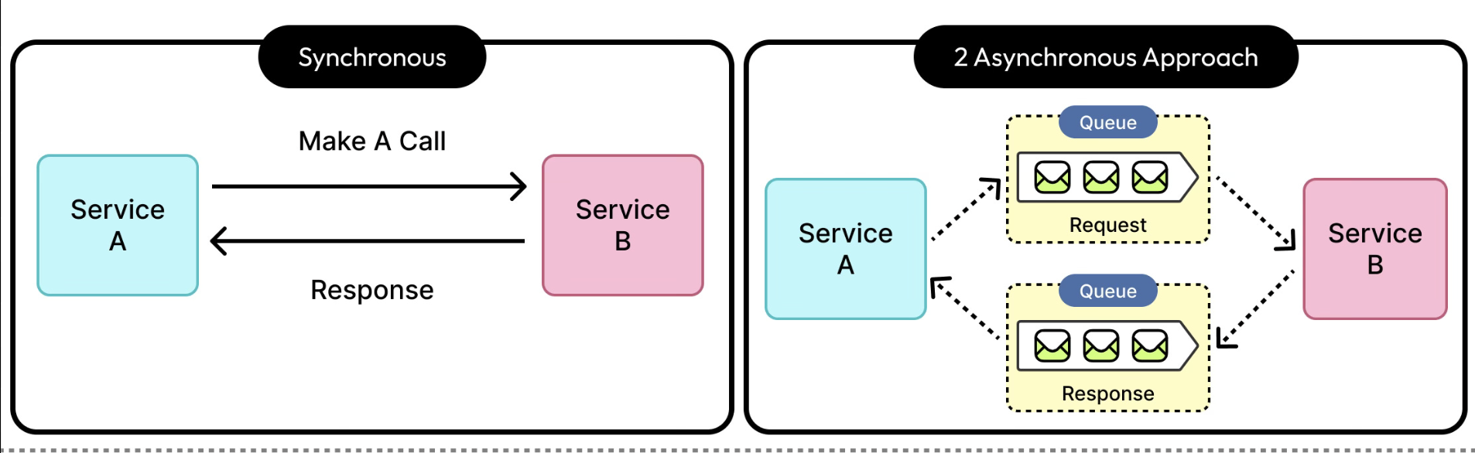
Why Asynchronous MPC Is difficult
Asynchrony Challenges
No timing guarantees
Message delays unpredictable
Delay and malicious behavior look identical
Many synchronous MPC techniques fail under asynchrony

Slide 4
Limitations of Prior Work (n/4 Barrier)
Previous Best Result: BCG93
Error-free asynchronous MPC possible only if t < n/4
Based on deterministic asynchronous Byzantine Agreement limits
More than 25% corruption → impossible to guarantee perfect correctness
Gap
n/4 limit is restrictive
Theoretical optimal resilience = n/3
Open question: can we reach n/3 if we allow negligible error?

Slide 5
Main Contribution of This Paper
Key Result
Asynchronous MPC achievable for t < n/3
Significance
Matches optimal resilience for asynchronous Byzantine Agreement
Major improvement over t < n/4
Trade-off
Allows an exponentially small probability of error Still considered cryptographically secure
Efficiency
Protocol runs in polynomial time when honest parties make progress

Slide 6
Challenges & High-Level Approach
Why n/3 Is Hard to Achieve
Classical Verifiable Secret Sharing (VSS) fails asynchronously
Honest players may not receive shares in time
Error-correcting methods require 3t+1 timely messages
Asynchronous networks guarantee only 2t+1 timely messages
Authors’ Approach
Introduce Ultimate Secret Sharing (USS)
Build an Asynchronous VSS using USS
Evaluate circuit securely using BGW-style gate computation
Establish full MPC protocol from these components

Slide 7
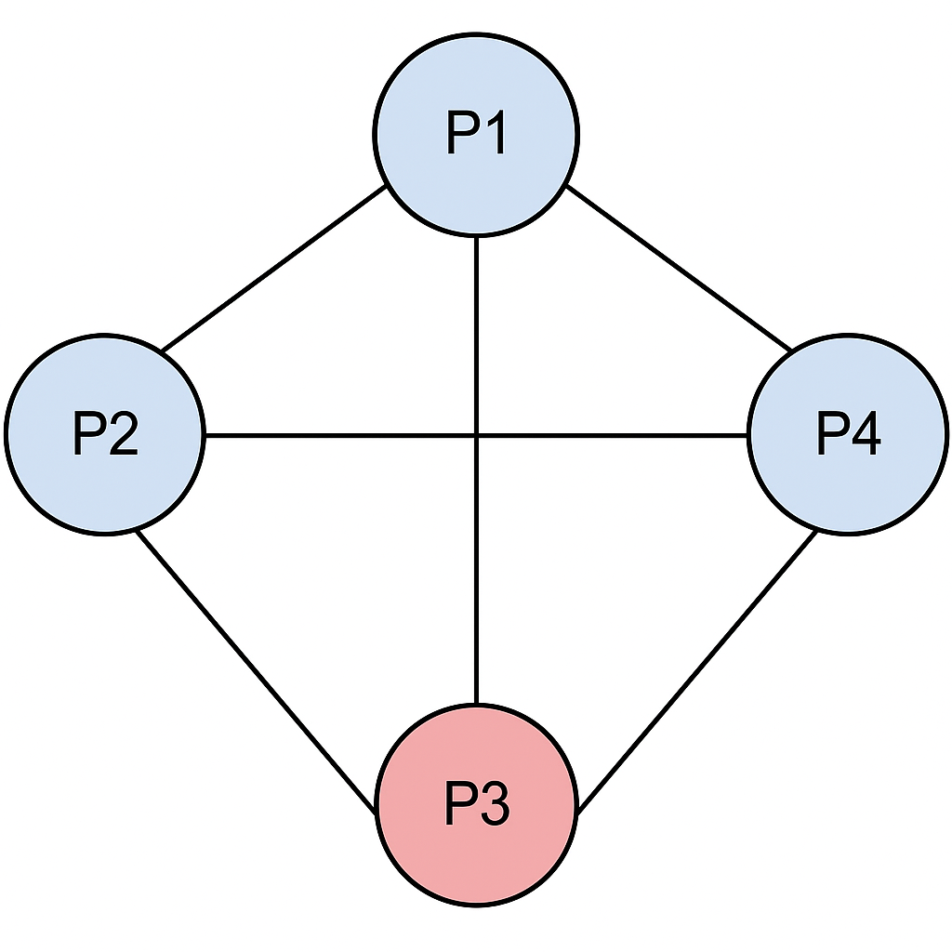
Definitions
Model, Asynchronous Computations, and Tools
The model consists of a fully connected asynchronous network of n players. Each pair has a secure, reliable point-to-point channel:
Secure: messages cannot be overheard.
Reliable but asynchronous: messages are eventually delivered, but with arbitrary (finite) delay.
Up to t of the players may become faulty at any time during the run of the protocol.
Where t must satisfy t<n/3
Notes:
This asynchrony is the core difficulty: without timing guarantees, the adversary can strategically delay honest players in ways that break many classical protocols.
The faulty players may deviate from their protocols, and collaborate in order to reveal private data of honest players, and even to disrupt the computation.

Slide 8
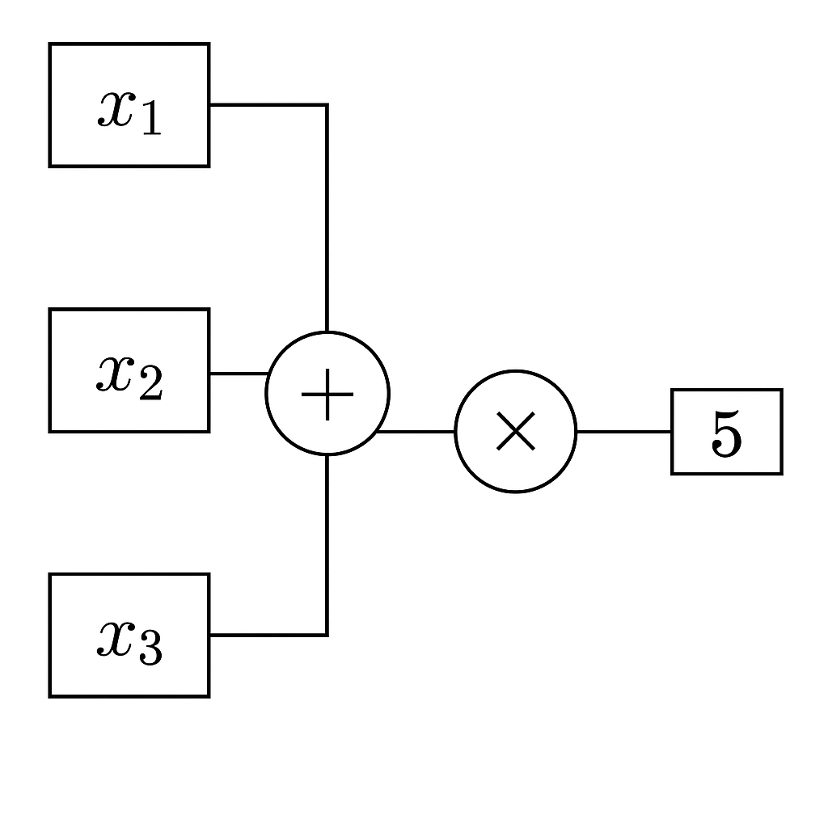
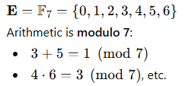
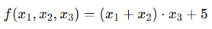
Definitions
Model, Asynchronous Computations, and Tools
The system allows up to t Byzantine faulty players. The t-adversary is:
Computationally unbounded: can perform any computation, regardless of how long it would take in reality
Dynamic: may corrupt players at any time, as long as the total ≤ t
Network scheduler: can arbitrarily delay messages but not modify or delete them
Faulty players reveal their state to the adversary and may send arbitrary messages.
Assume that a finite field E, with IEI > n, is used by all players.
The function to be computed is an n-variable polynomial F over E. An arithmetic circuit computing F is known to all the players 2.
Notes:
To model the faulty players’ behavior, we postulate a computationally unbounded, dynamic adversary. Once a player is picked by the adversary, he hands over to him all his private data, and gives the adversary the control on his next moves.
This “full-information adversary + asynchronous scheduler” is strictly stronger than synchronous or crash-fault models.

Slide 9
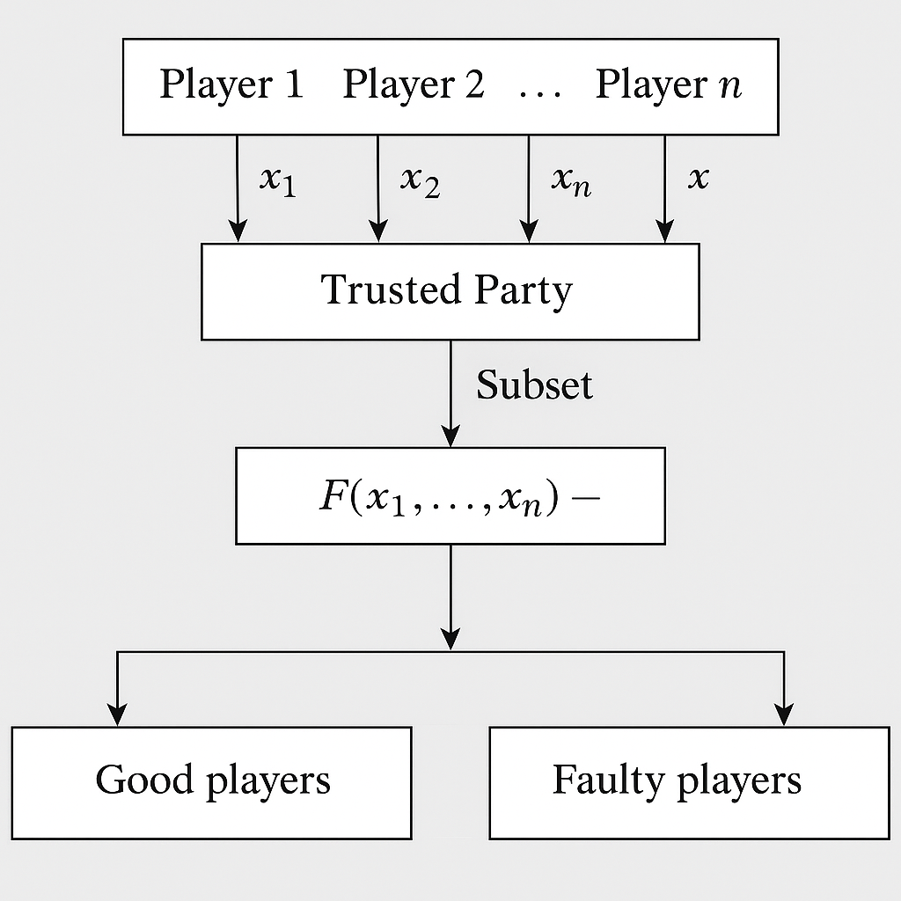
Definitions
Model, Asynchronous Computations, and Tools
Because players cannot wait for all inputs to appear, the paper adopts the ideal-functionality perspective from [BCG93]. In the trusted-party model:
Each player sends an input (faulty players may send anything) to a trusted party.
The adversary chooses a subset CompSet of at least n – t players whose inputs the trusted party receives.
Missing inputs are replaced with 0.
The trusted party outputs F(x₁,…,xₙ) evaluated on these padded inputs.
Good players output this value
Faulty players output an arbitrary function
Notes:
Each player Pi holds a private input Zi, and the players wish to securely compute the exact value of a function F(z1, . . . .Zn).
We say that an asynchronous protocol computes a function F in our model if the output of the players is equivalent to their output in the ideal trusted party scenario.
A real protocol is correct if it emulates this behavior.

Slide 10
Definitions
Model, Asynchronous Computations, and Tools
AWSS (Asynchronous Weak Secret Sharing): A lighter version of AVSS that provides weaker guarantees but is easier to implement.
Two-Sum Secret Sharing: A method of sharing three secrets such that the sum of two of them is guaranteed to equal the third.
Multiple Reconstruction of Secrets: A secret-sharing feature that allows a secret to be reconstructed privately for one party and later reconstructed publicly for everyone.
ZK Polynomial Degree Check: A zero-knowledge protocol for proving that distributed shares correspond to a polynomial of degree at most t without revealing the polynomial.
Product Zero-Knowledge Proof (Product ZKP): A protocol that proves three shared secrets satisfy a multiplicative relation (e.g., one equals the product of the other two) without revealing the secrets themselves.
The paper assumes access to several foundational sub-protocols, all implementable in asynchronous networks (with t < n/3). These include:
A-Cast (Asynchronous Broadcast Channel): A protocol that lets a sender reliably broadcast a message to all players in an asynchronous network, even if some are faulty.
Fast Asynchronous Byzantine Agreement (BA): A protocol that allows distributed parties to reach agreement on a value quickly despite asynchrony and malicious behavior.
AVSS (Asynchronous Verifiable Secret Sharing): A scheme where a dealer distributes a secret so that it can later be reconstructed, with built-in verification to prevent cheating in asynchronous settings.
Notes:
These tools form the building blocks of the new constructions in the paper.

Slide 11
Phase 1 — Input Sharing
Goal: Ensure every player’s input is committed, verifiable, and retrievable despite asynchrony and Byzantine faults.
Phase 2 — Gate-by-Gate Evaluation
The circuit is evaluated gate by gate using the secret-shared values.
Phase 3 — Output Reconstruction
Goal: Reveal the final result.
Phase | Substep | Tools Used | Purpose
1A Input Sharing | USS-share input | AVSS, AWSS, A-Cast, ZK Degree-Check | Commit and distribute input correctly
1B Agreement | Agree on valid inputs | BA, A-Cast | Consistent input set across honest players
2A Addition | Compute linear combo | AWSS, Two-Sum, Equality ZKP | Secure linear evaluation
2B Multiplication | Compute product | USS, AVSS, Product ZKP, Agreement, AWSS, Degree reduction, Random polynomials | Secure multiplication with degree reduction
3 Reconstruction | Reveal output | USS-Rec, Multiple Reconstruction | Correct, unique final result

Slide 12
Ultimate Secret Sharing
Enhance the secret sharing scheme
Goal: Design a secret sharing scheme where:
All honest players eventually obtain valid shares
Faulty shares can be detected
Every shared secret supports further computation (additions, multiplications)
Sh = the Share protocol (the protocol used by the dealer to distribute shares of the secret).
Rec (or Ret/“Rec”) = the Reconstruction protocol (the protocol used by players to reconstruct the secret from their shares).
Termination (with probability 1 − ε)
If dealer honest
⟶ all honest players finish Sh
If any honest player finishes Sh
⟶ all honest players eventually finish
If all honest players finished Sh and run Rec
⟶ all finish Rec
Notes:
As stated in the introduction, the AVSS scheme of [CR93] falls short of our needs in order to be able to compute.

Slide 13
Ultimate Secret Sharing
Enhance the secret sharing scheme
Goal: Design a secret sharing scheme where:
All honest players eventually obtain valid shares
Faulty shares can be detected
Every shared secret supports further computation (additions, multiplications)
Secrecy
If the dealer is honest and no honest player has begun executing protocol Ret, then the faulty players have no information about the shared secret.
Notes:
As stated in the introduction, the AVSS scheme of [CR93] falls short of our needs in order to be able to compute.

Slide 14
Ultimate Secret Sharing
Enhance the secret sharing scheme
Correctness After Sh completes, there exist:
a unique committed value r
shares β₁, …, βₙ
protocols L(i) for local access
protocol G(i) for public validation Such that:
If dealer honest → r = s
L(i) outputs βᵢ
If G(i) outputs non-null → it equals βᵢ
Reconstruction using all G(i) yields r
βᵢ: The canonical “correct” share for Pᵢ. Defines the true underlying polynomial.
L(i): Local extraction of βᵢ. Each honest player computes their own proper share.
G(i): Globally accepted share. Used safely in reconstruction
Goal: Design a secret sharing scheme where:
All honest players eventually obtain valid shares
Faulty shares can be detected
Every shared secret supports further computation (additions, multiplications)
Notes:
The protocol L(.) ensures that each player can access his share of the secret. The self correcting property is embedded in the protocol G(.). The output of this function may be null (for faulty players), but if it is not null then it is guaranteed to be a proper share.
In the definition, once an honest player finishes Sh, there must exist:
a unique secret r,
a unique set of consistent shares β₁,…,βₙ,
functions L(i) and G(i) for each player.
These objects formalize how the protocol corrects errors and ensures consistent shares, even if the dealer was faulty.

Slide 15
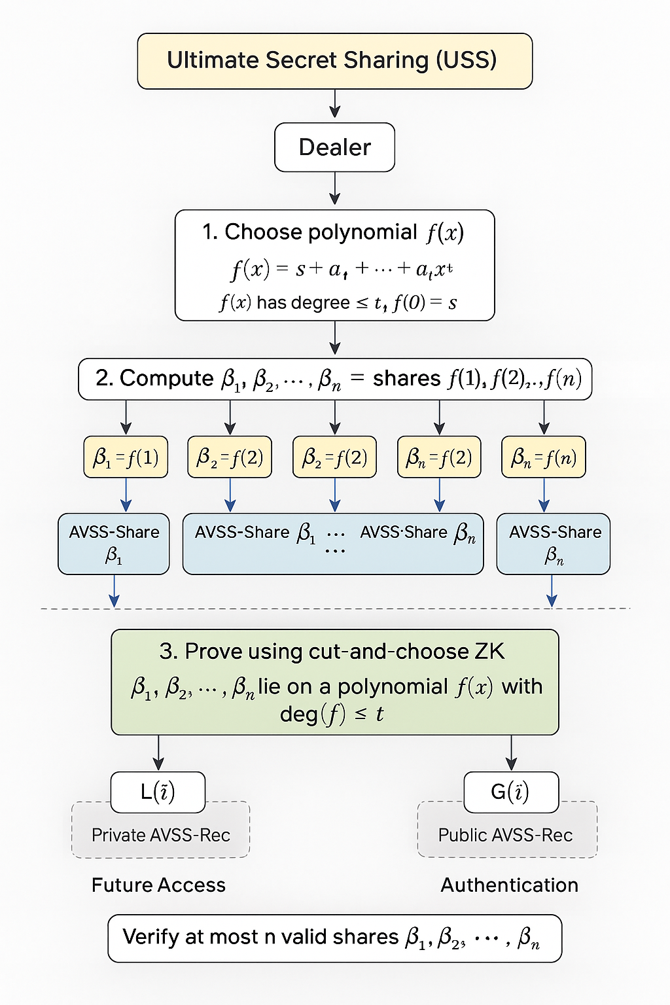
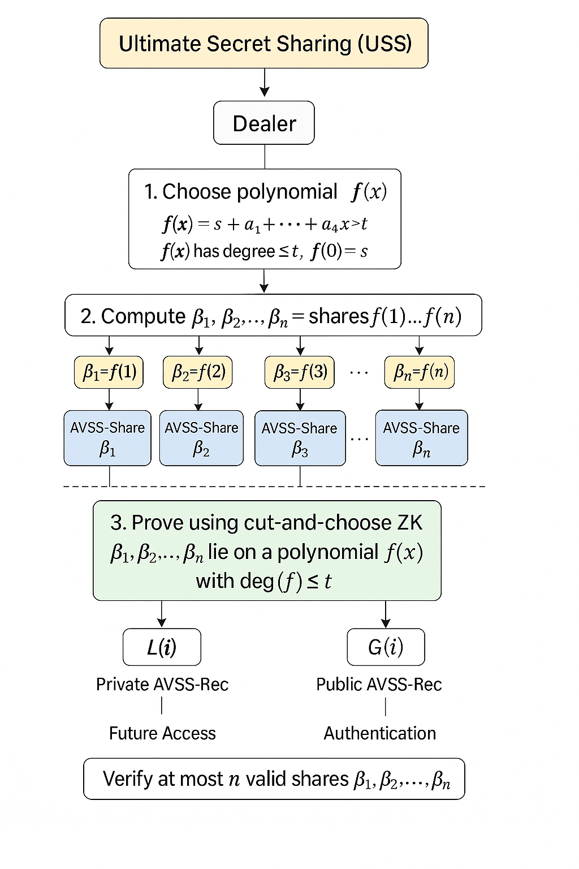
Ultimate Secret Sharing
Enhance the secret sharing scheme
Step 1 — Dealer chooses a polynomial f(x)
degree ≤ t
f(0) = s (the secret)
Step 2 — Compute normal shares βᵢ = f(i)
Step 3 — For each βᵢ, dealer runs AVSS-Share
This gives:
commitment to βᵢ
ability for any Pi to reconstruct βᵢ later
protection against message delays
Step 4 — Dealer proves all βᵢ form a degree-t polynomial
Cut-and-choose ZK proof guarantees validity.
Step 5 — Players can later do:
L(i): private AVSS-Rec to get βᵢ
G(i): public AVSS-Rec to authenticate βᵢ
Notes:
Due to the properties of AVSS-Share, he is now committed to n values. He proceeds to prove that these values are proper shares. He does this using the cut and choose zero knowledge technique [CCD88] for proving that n values define a polynomial of degree ~ t.

Slide 16
Correctness & Resilience of USS (Ultimate Secret Sharing)
Lemma: For n ≥ 3t+1, the pair USS-Share[ε] and USS-Rec[ε] forms a (1–ε)-correct, t-resilient Ultimate Secret Sharing scheme.
Meaning: With high probability, all honest players get their correct shares.
Works even when up to t players are faulty.
Ensures safe secret sharing in an asynchronous system.

Slide 17
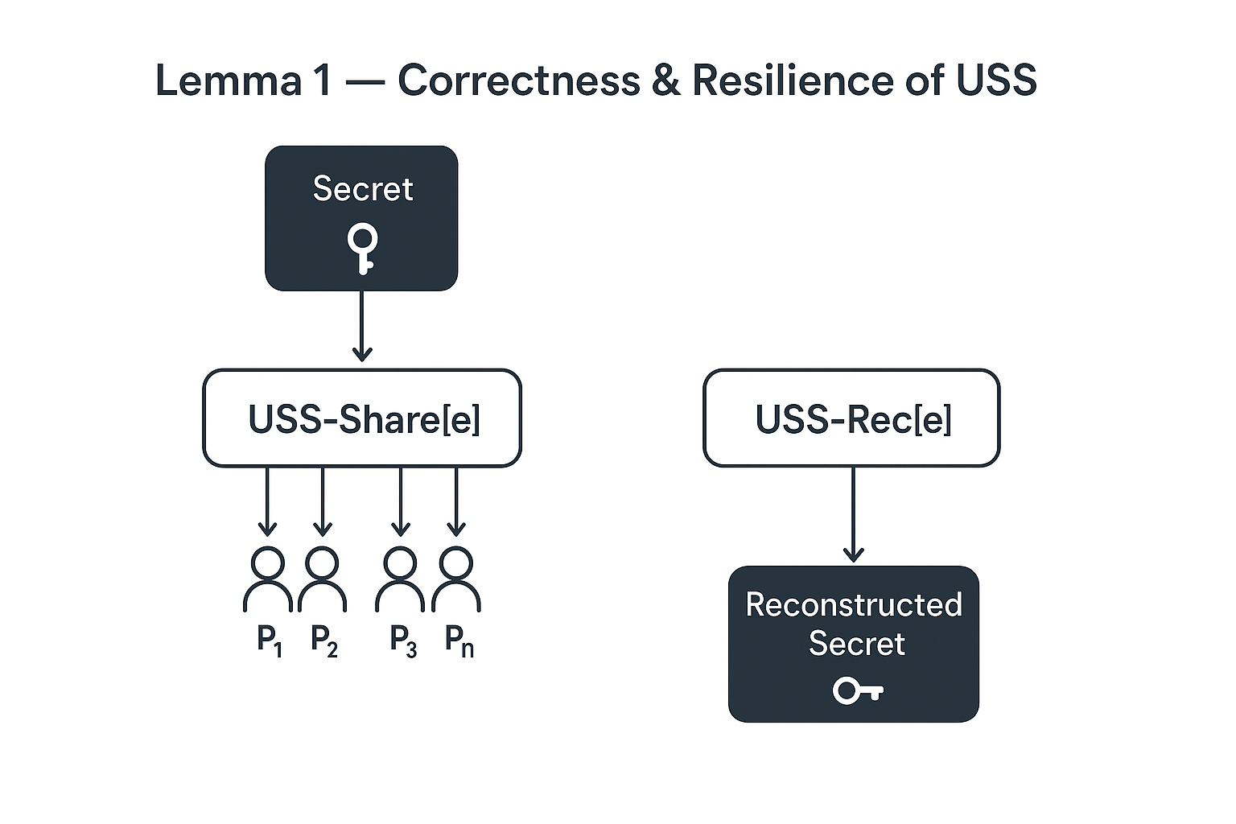
What the USS Scheme Ensures
Termination: All honest players finish sharing
and reconstruction with probability ≥ 1–ε.
Secrecy: Faulty players learn nothing about
the secret unless reconstruction begins.
Correctness: All honest players reconstruct
the same unique secret value.
Resilience: System remains correct even if
t players act maliciously.

Slide 18
Agreement On a Common Subset
Players need to agree on which players did things correctly.
Each player j is assigned a value Q(j) (0 or 1), meaning whether j satisfied some property.
All honest players will eventually get Q(j)=1, but some faulty players might also claim 1.
Goal: All honest players agree on the same set of valid players with Q(j)=1, and that set must contain at least 2t+1 players.
Idea: Run n Byzantine Agreement (BA) protocols in parallel i.e one BA for each player.

Slide 19
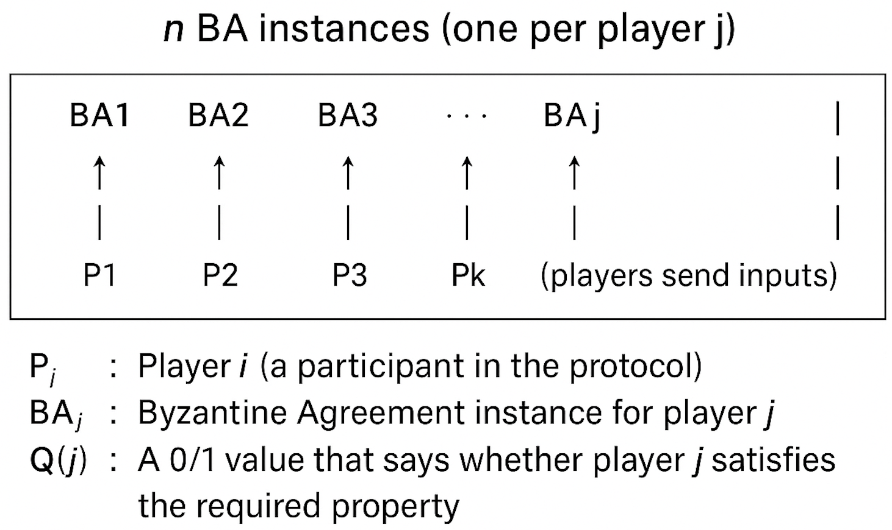
Visual Representation of the Agreement Protocol Setup
If Pi learns Q(j)=1, it inputs 1 to BAj.
All n BA instances run in parallel and output 0/1.
When any honest player sees 2t+1 outputs = 1, it inputs 0 to the remaining BAs (ensures termination).
After all BA outputs are ready, each player sets: Subset = { j | BAj outputs 1 }

Slide 20
Computation Protocol
Problem
Result
Perform computation with 2 secret values u, v without telling the replicas what these values are.
All trusty parties should compute and output the same correct value, z

Slide 21
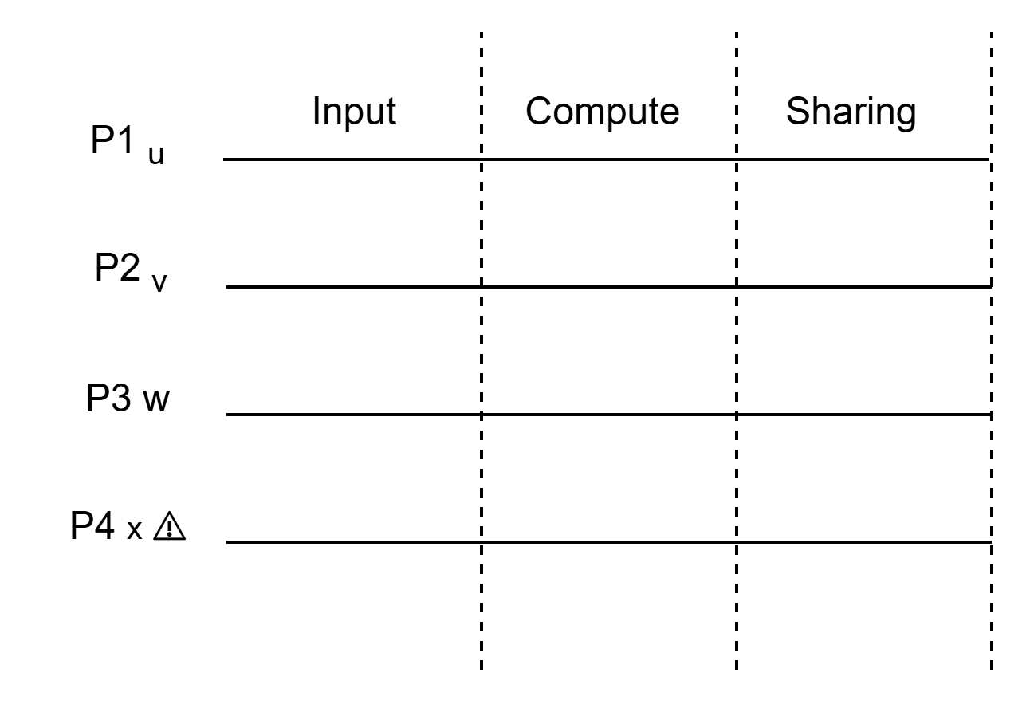
Linear combination
Compute z = cu + c’v
u -> (u₁, u₂, u₃), v ->(v₁, v₂, v₃)

Slide 22
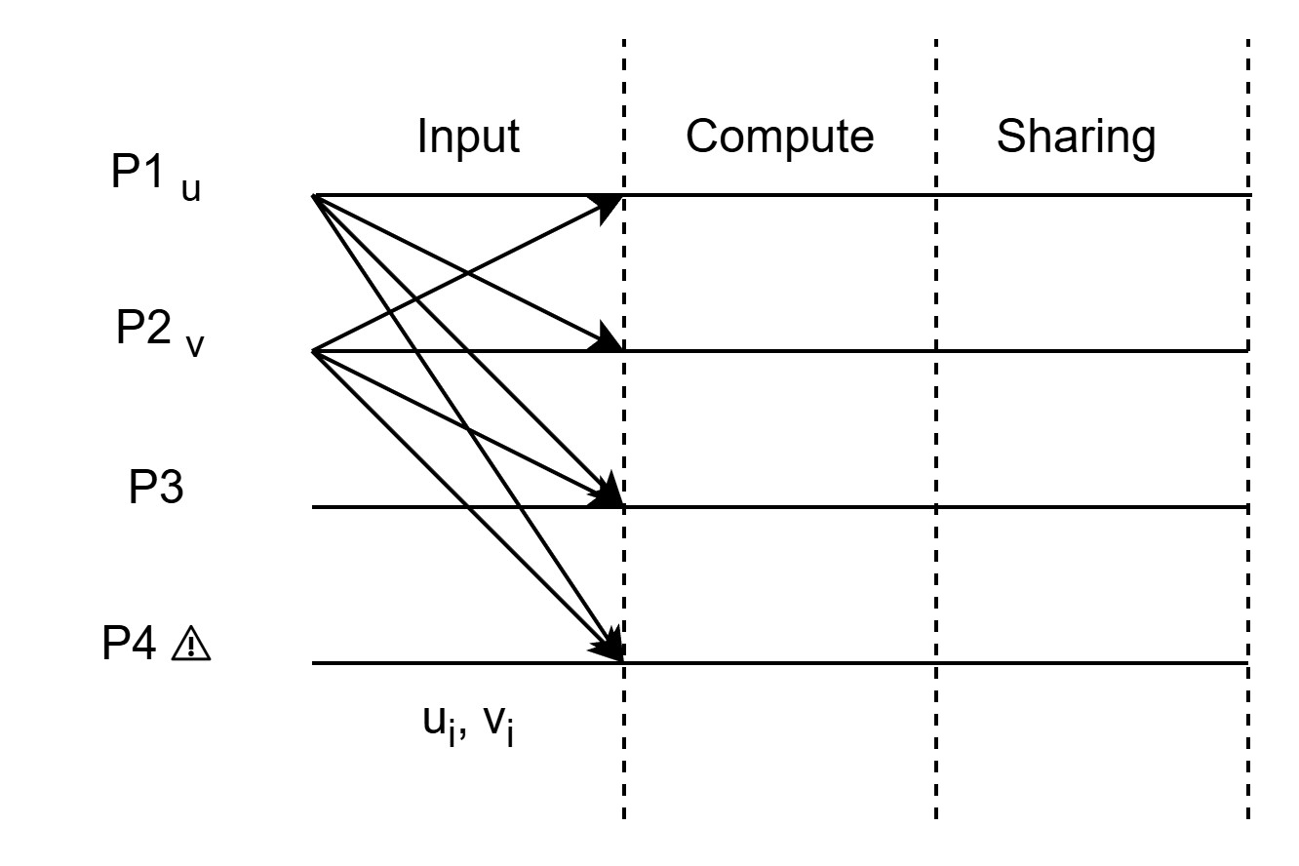
Linear combination
Compute z = cu + c’v
u -> (u₁, u₂, u₃), v ->(v₁, v₂, v₃)
Input: Share u_{i}, v_{i}
Protocol - AVSS-Share

Slide 23
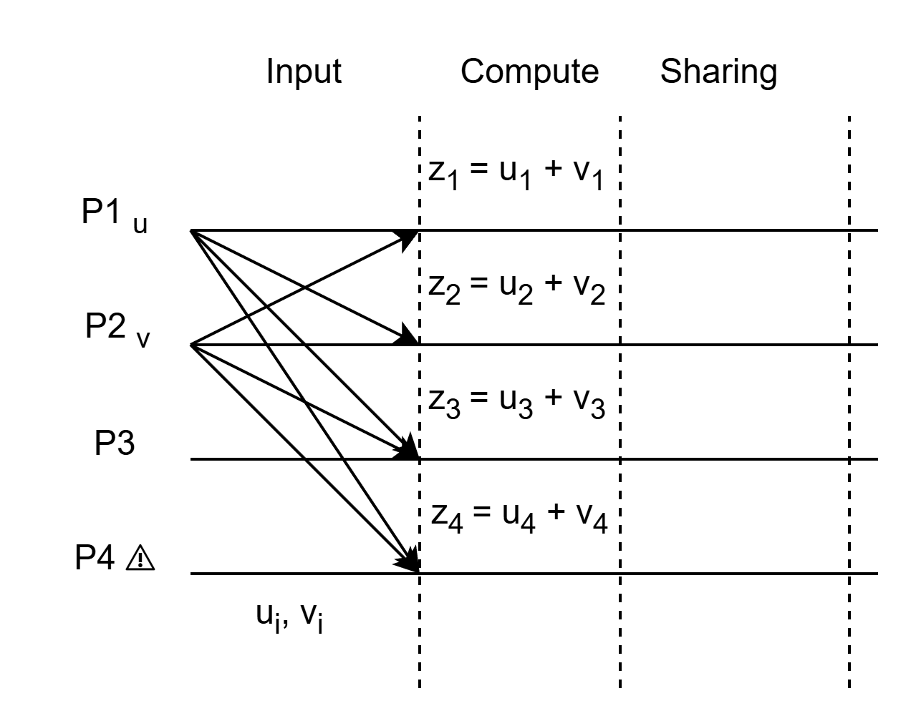
Linear combination
Compute z = cu + c’v
u -> (u₁, u₂, u₃), v ->(v₁, v₂, v₃)
Input: Share u_{i}, v_{i}
Protocol - AVSS-Share
Computation: Locally comptute z_{i} = u_{i} + v_{i}

Slide 24
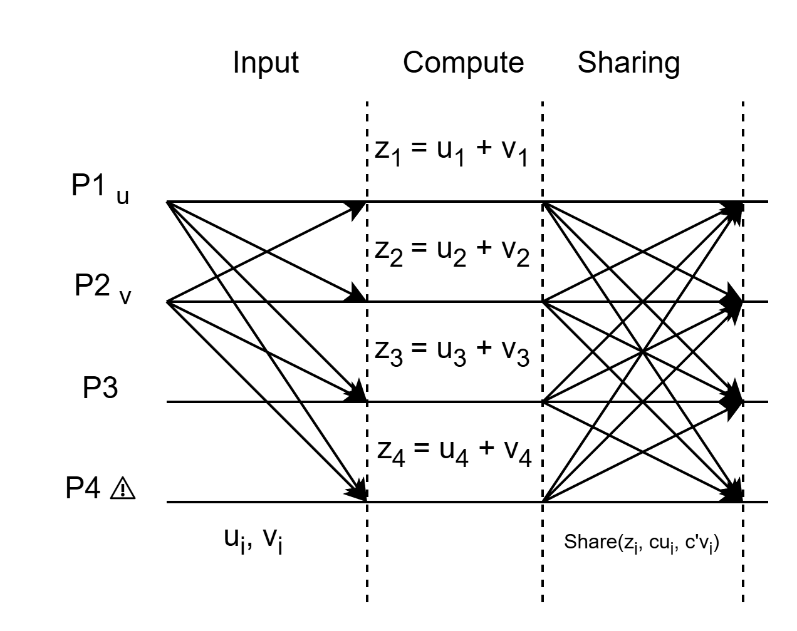
Linear combination
Compute z = cu + c’v
u -> (u₁, u₂, u₃), v ->(v₁, v₂, v₃)
Input: Share u_{i}, v_{i}
Protocol - AVSS-Share
Computation: Locally comptute z_{i} = cu_{i} + c’v_{i}
Sharing: Share (z_{i}, u_{i}, v_{i})
Protocol - Two&Sum-AWSS
Subset Agreement: z -> (z₁ , z₂ , z₃ )
Compute function: z = (z₁ + z₂ + z₃ )

Slide 25
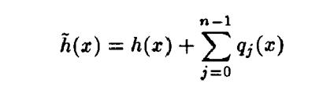
Product computation
What’s the problem?
Compute z = uv
u and v are polynomial functions.
→ f^{u}(x) = S+a₁x+a₂x²+...+a_{t}x^{t}
→ g^{v}(x) = S’+a₁x+a₂x²+...+a_{t}x^{t}
f^{u}(x) · g^{v}(x) gives 2t degree : If we multiply one more function it will not be secure for asynchronous system, as 3t degree needs 3t+1 participation.
Solution
Perform degree reduction and randomization on h^{z}(x) = f^{u}(x) · g^{v}(x) [BGW88]

Slide 26
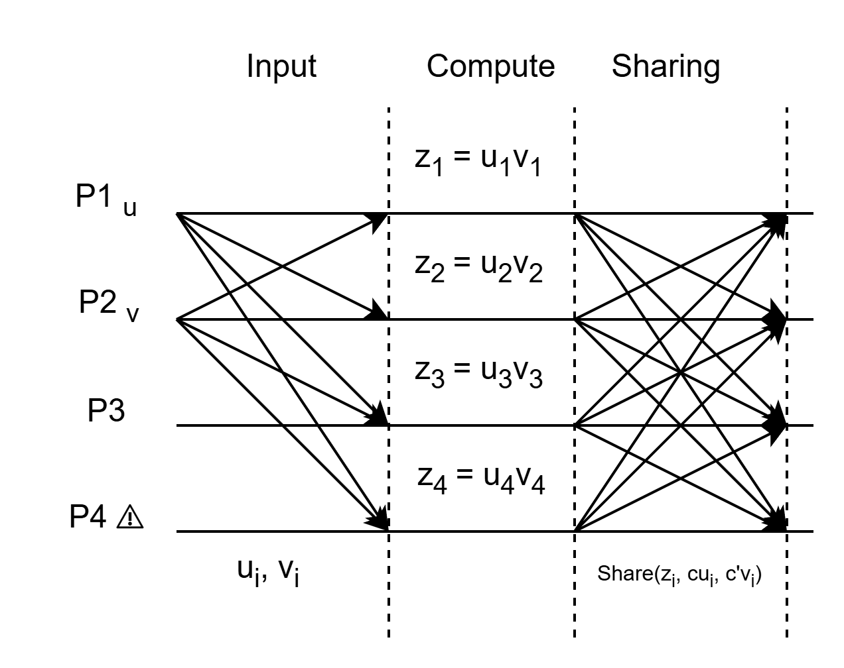
Product computation
Input: Share u_{i}, v_{i}
Protocol - AVSS-Share
Computation:
Locally comptute z_{i} = u_{i}v_{i}
Sharing: Share (z_{i}, u_{i}, v_{i})
Protocol - USS-Share to share z_{i}
AVSS-Share to share u_{i} and v_{i}
Product ZKP to prove that z_{i} = u_{i}v_{i}
Subset Agreement: z -> (z₁ , z₂ , z₃ )
Degree reduction / Randomization: Perform degree reduction and randomization making z_{i} into t degree polynomial function that can be securely shared
Protocol - BGW88 for degree reduction & randomization
- Linear Combination to compute transfomation
Output: Reconstruct the reduced degree function to get z

Slide 27
Why Asynchronous MPC Cannot Tolerate t ≥ n/3
Fundamental lower bound: n > 3t is required
If t ≥ n/3, adversary can partition network into ≥2 indistinguishable groups
Honest-majority intersections break: no guaranteed overlap of shares between different sets of players who respond
No asynchronous Byzantine agreement possible → MPC impossible
Bound is information-theoretic, cannot be bypassed with cryptography

Slide 28
Achieving the Optimal Bound (t < n/3)
Protocol uses: AVSS + Reliable Broadcast + ABA
Each primitive requires the same threshold n > 3t
Intersection arguments ensure:
a) Consistent secret reconstruction b) Guaranteed agreement on shared randomness c) No ambiguity even under async scheduling
The final MPC construction inherits this optimality
Result: Perfect security + guaranteed termination under max feasible corruption

Slide 29
Why This Paper Matters
First general asynchronous MPC protocol with information-theoretic security
Established AVSS as a core primitive for all later asynchronous systems
Foundation for modern ABFT systems:
a) HoneyBadgerBFT b) Asynchronous DKG c) Threshold signatures d) Randomness beacons
Introduced long-lasting ideas:
Degree-reduction in asynchronous setting
VSS with malicious, rushing adversaries
Asynchronous BA via VSS-based shared coins

Slide 30
Discussion: Key Insights
Demonstrates that secure MPC is achievable even in a fully asynchronous network with malicious faults
Protocol relies on AVSS, Reliable Broadcast, and Asynchronous Byzantine Agreement, all operating under the same threshold
Guarantees consistency without timing assumptions, using only intersection arguments
Notes challenges: high communication cost and probabilistic termination

Slide 31
Conclusion: Final Results & Impact
Achieves the optimal resilience bound:
t < n/3
Ensures perfect privacy, perfect correctness, and eventual termination
Establishes a foundation for modern asynchronous BFT and MPC systems
Main takeaway:
Secure asynchronous computation is possible only under the tight constraint n>3tn, and this protocol reaches that limit.

